Slide 1


A Health Care Mobile Application
A.K.M. Amirul Islam
Track # 3846 (ITSS)
Android Mobile Application Development

Slide 2
A Health Care Mobile Application
Diet Chart
  Create, Update & Delete Diet Chart
  Set Alarm
Vaccination
  Create, Update & Delete Vaccination
  Set Remainder
Doctor Profile
  Create, Update, Delete Doctor Profile
  Call, SMS, Email to Doctor
Medical History
  Create, Update & Delete Medical History (with Prescription)
Care Centre Information
General Health Tips

Slide 3
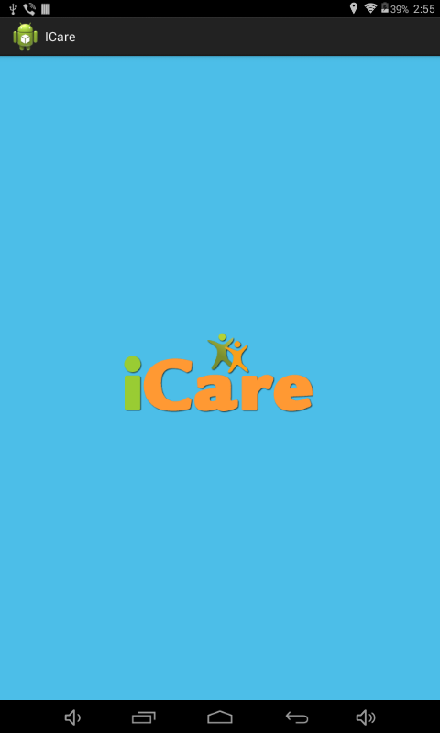
Splash
Screen
A Health Care Mobile Application

Slide 4
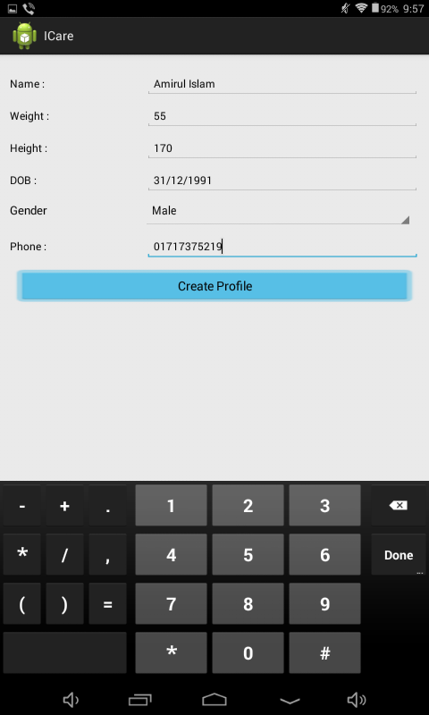
Profile Creation for the first time only
A Health Care Mobile Application

Slide 5
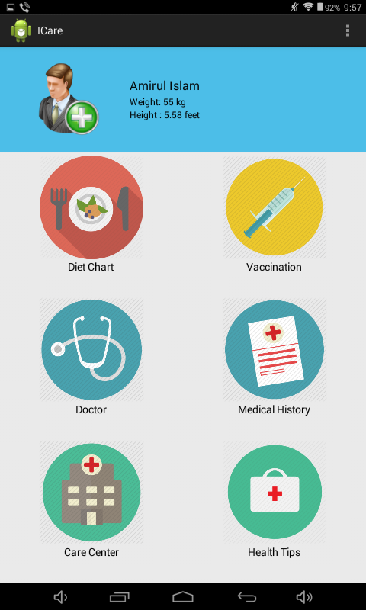
Home Page (Dashboard)
A Health Care Mobile Application
View Profile

Slide 6
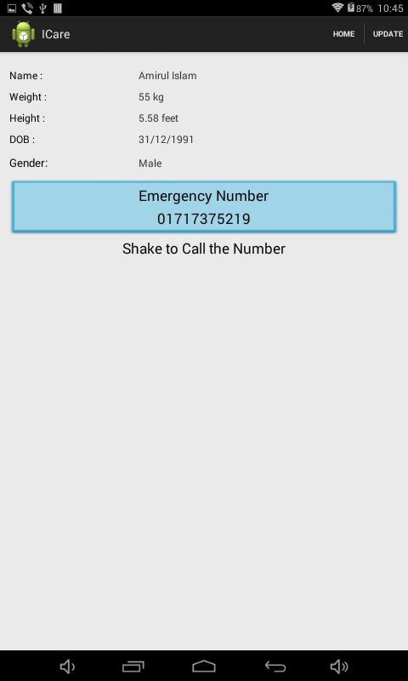
Profile View Page
A Health Care Mobile Application

Slide 7
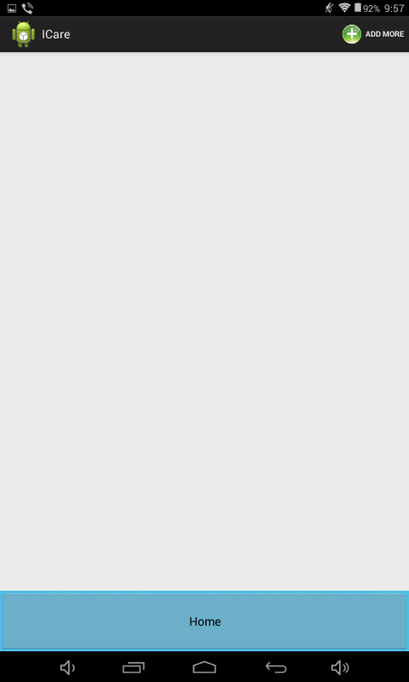
Diet Chart List (Empty)
A Health Care Mobile Application
Add New Diet

Slide 8
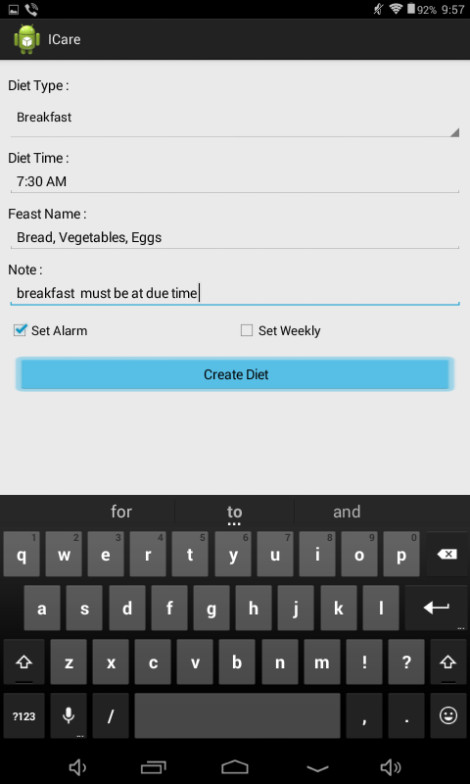
Add New Diet Page
A Health Care Mobile Application

Slide 9
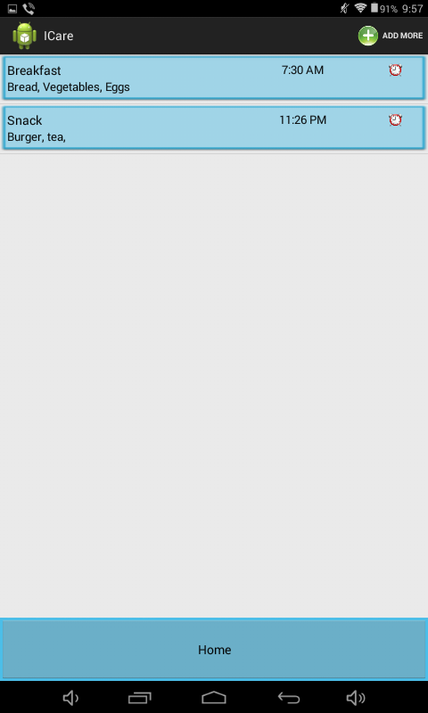
A Health Care Mobile Application
Diet Chart List

Slide 10
A Health Care Mobile Application
Add Vaccination
Vaccination List (Empty)

Slide 11
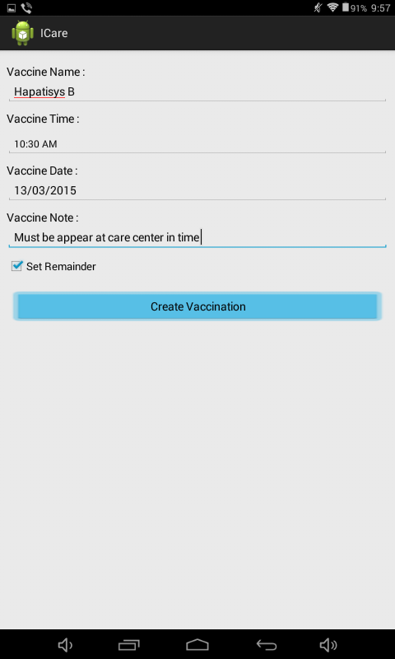
A Health Care Mobile Application
New Vaccination Page

Slide 12
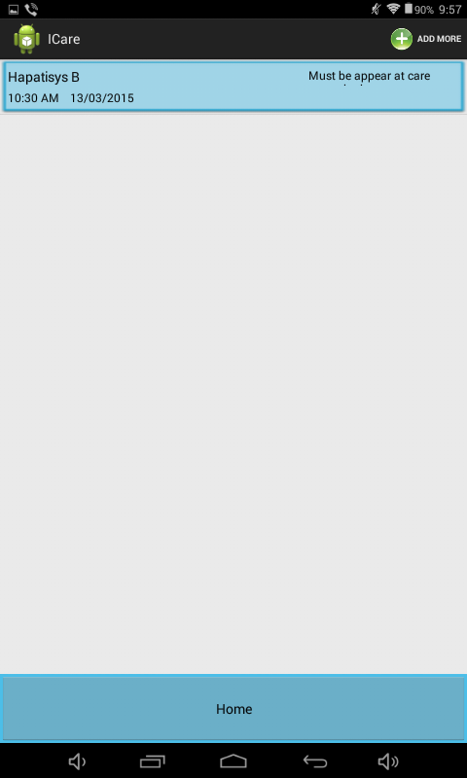
A Health Care Mobile Application
Vaccination
List

Slide 13
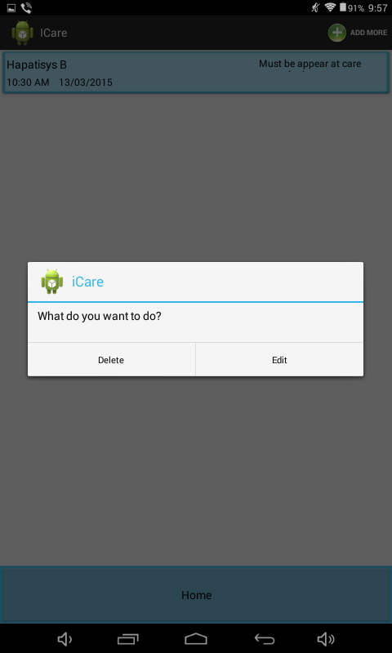
On List Item Clicked Menu
A Health Care Mobile Application
Delete
Edit

Slide 14
A Health Care Mobile Application
A Health Care Mobile Application
Add Doctor
Doctor Profile
List
(Empty)

Slide 15
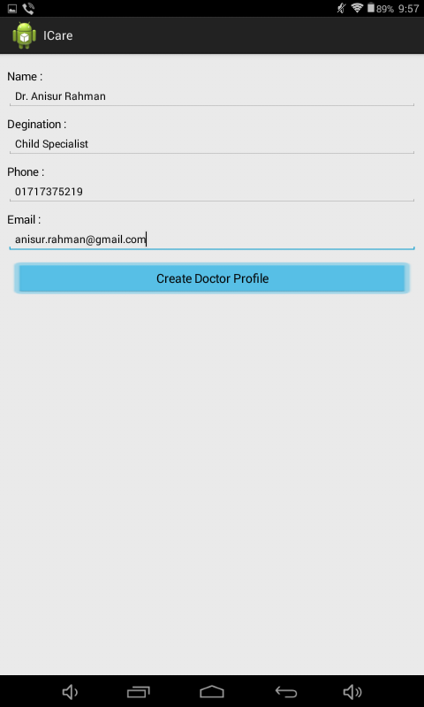
A Health Care Mobile Application
A Health Care Mobile Application
New Doctor
Page

Slide 16
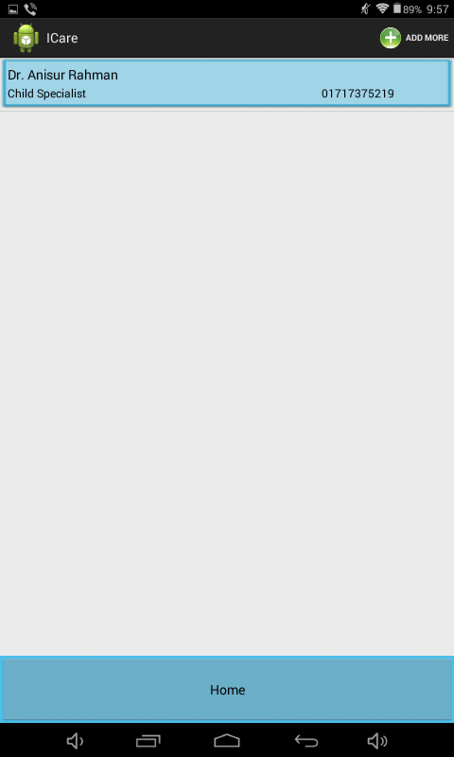
A Health Care Mobile Application
A Health Care Mobile Application
Doctor List

Slide 17
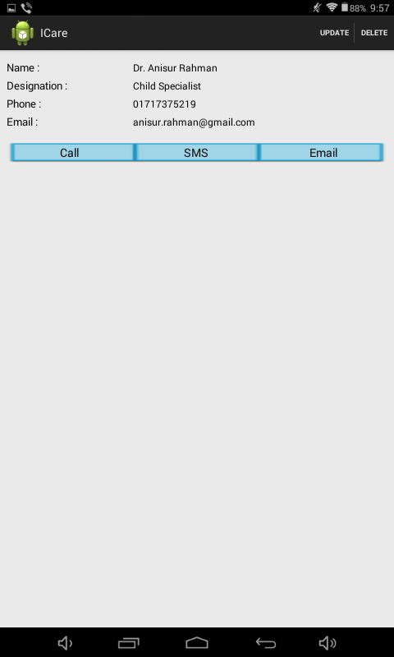
Doctor Profile View Page
A Health Care Mobile Application
A Health Care Mobile Application
Update / Delete
Call
SMS
Email

Slide 18
A Health Care Mobile Application
A Health Care Mobile Application
Add History
Medical History
(Empty)

Slide 19
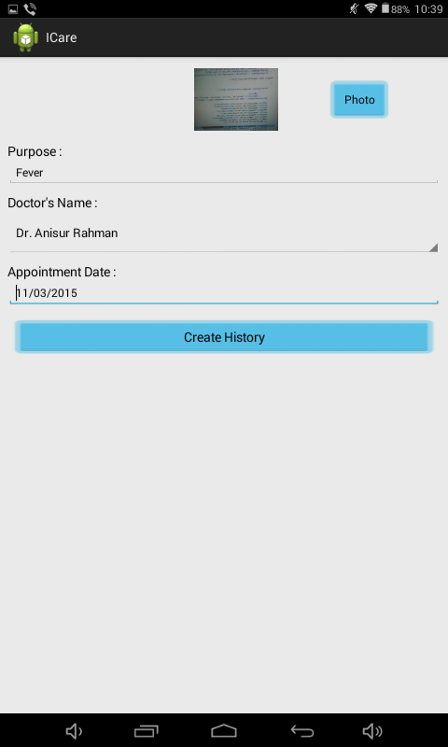
Medical History Create Page
A Health Care Mobile Application
A Health Care Mobile Application

Slide 20
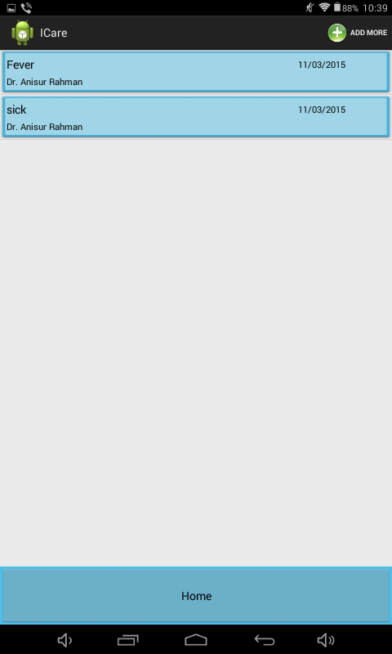
A Health Care Mobile Application
A Health Care Mobile Application
Medical History
List

Slide 21
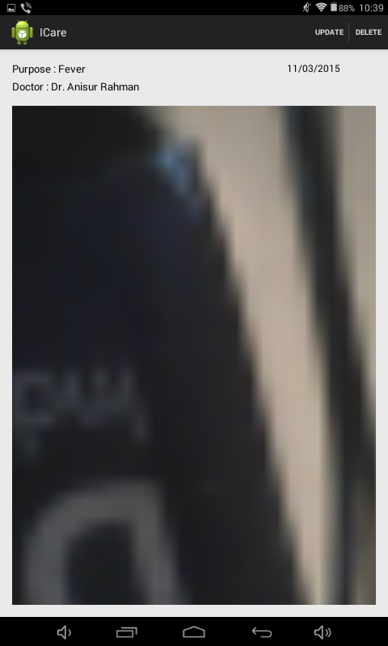
A Health Care Mobile Application
A Health Care Mobile Application
Medical History View Page
Zoom View Of Medical Prescription

Slide 22
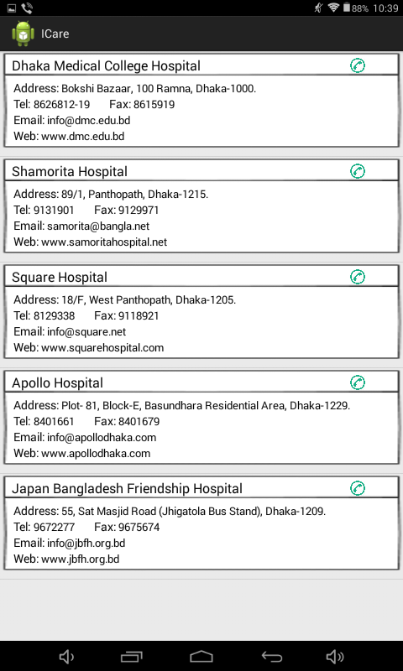
A Health Care Mobile Application
A Health Care Mobile Application
Mailing Address
Telephone
Fax
Email
Web Address
Care Center Information

Slide 23
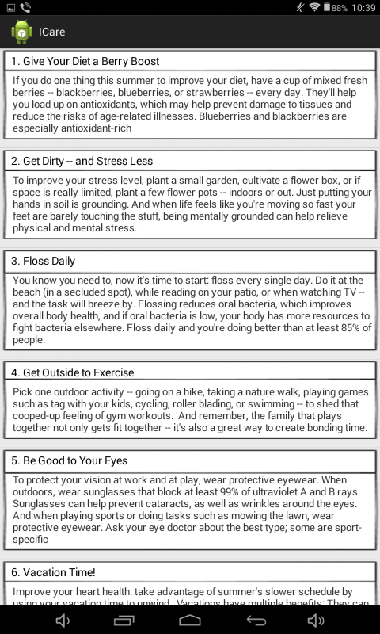
A Health Care Mobile Application
A Health Care Mobile Application
General Health Tips

Slide 24
Thank You

